Slide 1
Human Figure Drawing
Standing Pose and its Proportions

Slide 2
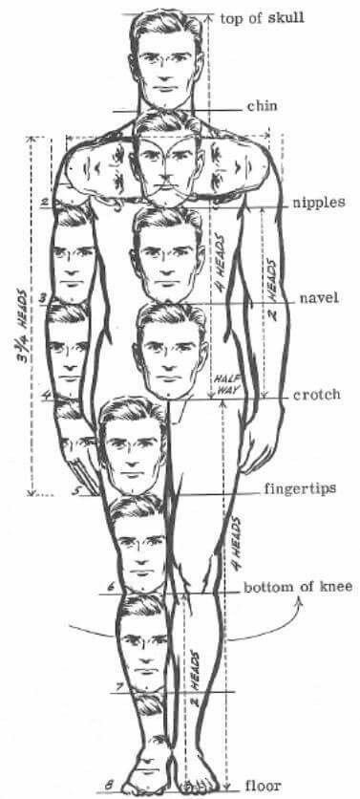

Slide 3
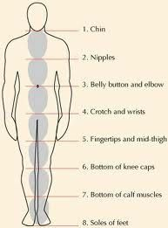

Slide 4
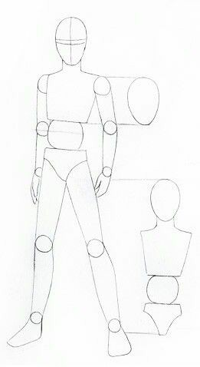

Slide 5
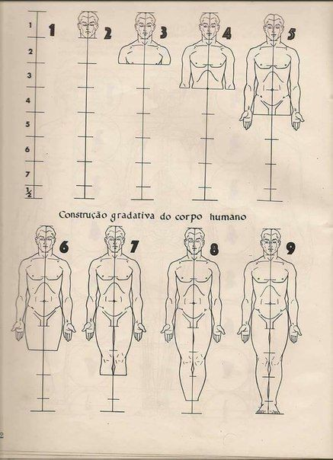

Slide 6
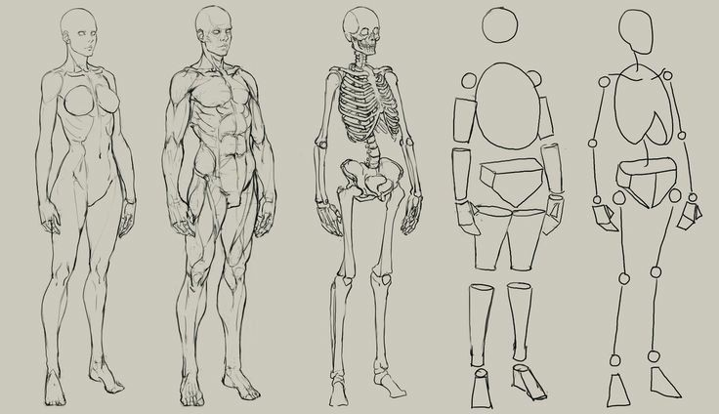

Slide 8
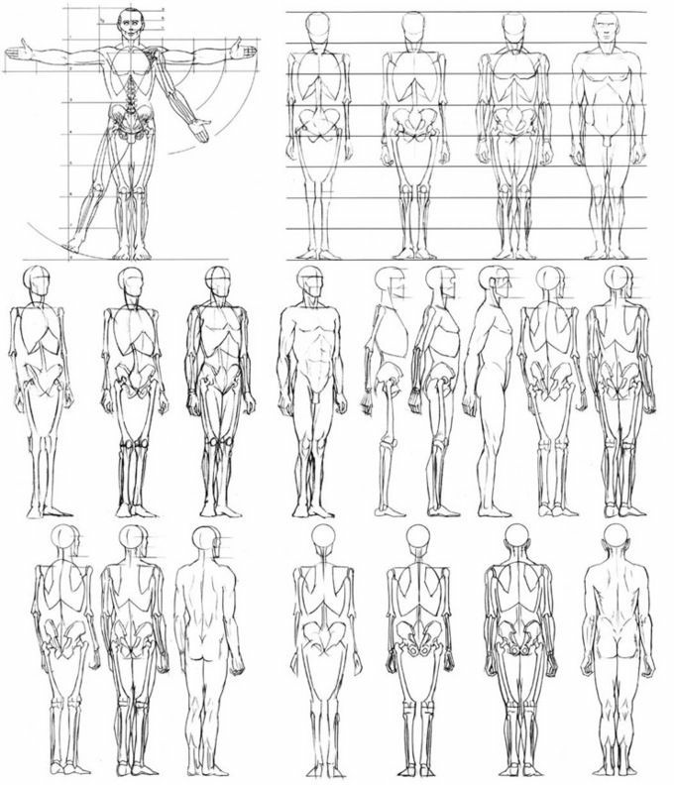

Slide 9
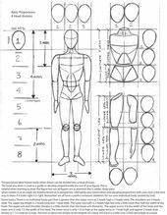

Slide 10
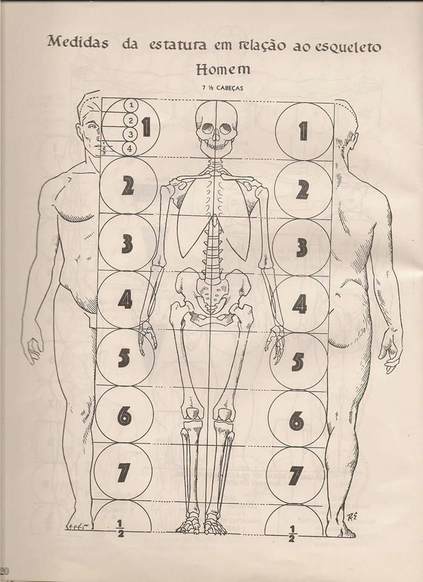

Slide 11
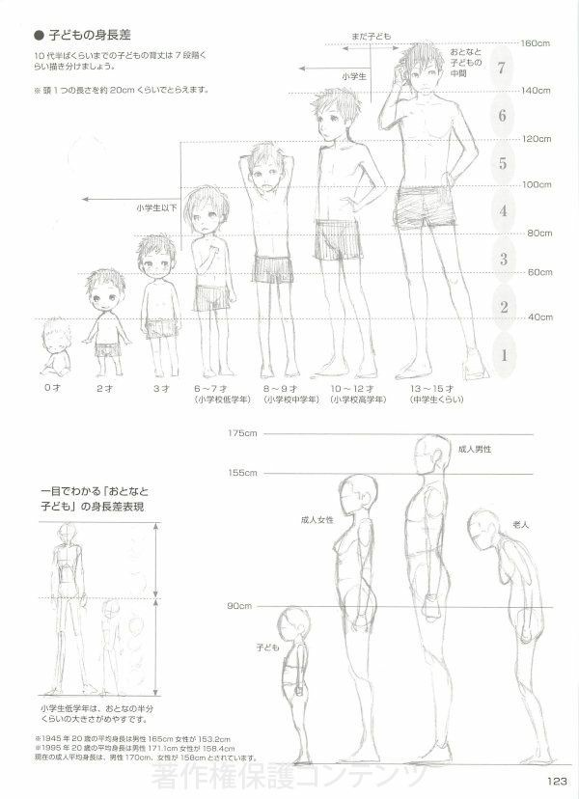

Slide 12
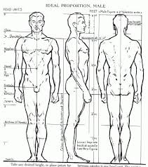

Slide 14
Links
https://www.youtube.com/watch?v=GzaJS-udeDkhttps://www.youtube.com/watch?v=lNlekvNYY00
https://www.youtube.com/watch?v=7WMjuz81rJM

